Slide 1
Code Example 6-2
// cx6-2.cpp
// Code Example 6-2: Recursively computing powers of 2
#include <iostream.h>
int twoRaisedTo(int n)
{
if (n == 0) // special case
return 1;
else
return 2 * twoRaisedTo(n-1);
}
26年 11月 8日
Copyright © 1997 Oxford University Press
All Rights Reserved

Slide 2
Code Example 6-2
int main()
{
cout << "2 to the 5th is " << twoRaisedTo(5) << "\n";
return 0;
}
26年 11月 8日
Copyright © 1997 Oxford University Press
All Rights Reserved

Slide 3
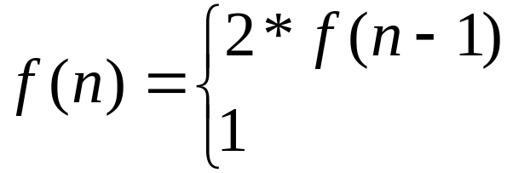
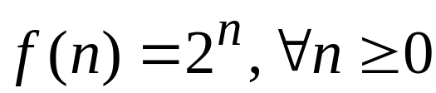
Equation 6-1
When n >= 1
When n = 0
Equation 6-2
26年 11月 8日
Copyright © 1997 Oxford University Press
All Rights Reserved

Slide 4
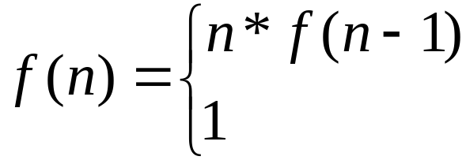
Equation 6-5
Equation 6-6
When n >= 1
When n = 0
26年 11月 8日
Copyright © 1997 Oxford University Press
All Rights Reserved

Slide 5
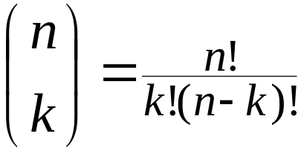
Equation 6-7
Equation 6-8
Total number of sets = sets with “Stairway” + sets without “Stairway”
26年 11月 8日
Copyright © 1997 Oxford University Press
All Rights Reserved

Slide 6
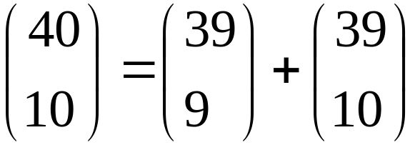
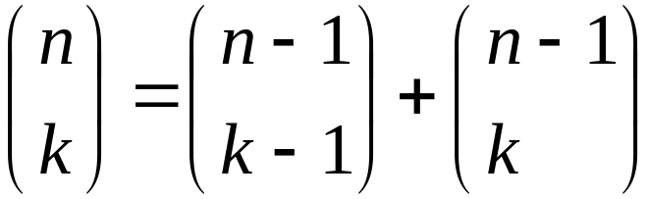
Equation 6-9
Equation 6-10
26年 11月 8日
Copyright © 1997 Oxford University Press
All Rights Reserved

Slide 7
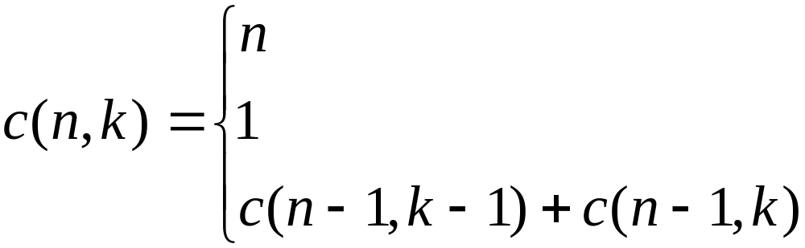
Equation 6-11
Equation 6-12
when k = 1
when n = k
when n > k and k > 1
26年 11月 8日
Copyright © 1997 Oxford University Press
All Rights Reserved

Slide 8
Code Example 6-3
// cx6-3.cpp
// Code Example 6-3: The n choose k function
int choose(int n, int k)
{
if (k == 1)
return n;
else if (n == k)
return 1;
else // recursive case: n>k and k>1
return choose(n - 1, k - 1) + choose(n - 1, k);
}
26年 11月 8日
Copyright © 1997 Oxford University Press
All Rights Reserved

Slide 9
실습
Combination 을 recursive 로 구현한 내용을 프로젝트로 완성한다.
  Main 함수에서 입력을 받고 조합을 출력한다.
  Global 변수를 한 개 선언해서 함수를 몇번 부른지를 조사해보자
    값을 바꾸어 가면서(작은수 부터 큰수로)
26年 11月 8日
Copyright © 1997 Oxford University Press
All Rights Reserved

Slide 10
Figure 6-1: Visualization of recursive Linear Search
use recursive call linearSearch(a, n-1, target) for this part
a[0] through a[n-2]
a[n-1]
26年 11月 8日
Copyright © 1997 Oxford University Press
All Rights Reserved

Slide 11
Code Example 6-4
// cx6-4.cpp
// Code Example 6-4: Recursive Linear Search
int linearSearch(int a[], int n, int target)
{
// Recursive version of linear search
// Precondition: a is an array indexed from 0 to n-1
if (n <= 0) // an empty list is specified
return -1;
else {
26年 11月 8日
Copyright © 1997 Oxford University Press
All Rights Reserved

Slide 12
Code Example 6-4
if (a[n-1] == target) // test final position
return n-1;
else // search the rest of the list recursively
return linearSearch(a, n-1, target);
}
// Postcondition: If a value between 0 and n-1 is returned,
// a[returnValue] == target;
// Otherwise, if -1 is returned, target is not in a
}
26年 11月 8日
Copyright © 1997 Oxford University Press
All Rights Reserved

Slide 13
Algorithm 6-1
Preconditions: a is an array sorted in ascending order,
first is the index of the first element to search,
last is the index of the last element to search,
target is the item to search for.
If first > last
return failure
mid <-(first+last)/2
if a[mid] is equal to target
return mid
26年 11月 8日
Copyright © 1997 Oxford University Press
All Rights Reserved

Slide 14
Algorithm 6-1
else if target < a[mid]
return result of recursive search of a from first upto mid-1
else
return result of recursive search of a from mid+1 upto last
Postcondition: value returnded is position of target ina, otherwise return failure
We can easily turn Algorithm 6-1 into Code Example 6-5.
We indicate “failure” by returning the value -1.
26年 11月 8日
Copyright © 1997 Oxford University Press
All Rights Reserved

Slide 15
Code Example 6-5
// cx6-5.cpp
// Code Example 6-5: Recursive Binary Search
int binarySearch(int a[], int first, int last, int target)
{
// Preconditions: a is an array sorted in ascending order,
// first is the index of the first element to search,
// last is the index of the last element to search,
// target is the item to search for.
if (first > last)
return -1; // -1 indicates failure of search
int mid = (first+last)/2;
26年 11月 8日
Copyright © 1997 Oxford University Press
All Rights Reserved

Slide 16
Code Example 6-5
if (a[mid] == target)
return mid;
else if (target < a[mid])
return binarySearch(a, first, mid-1, target);
else // target must be > a[mid]
return binarySearch(a, mid+1, last, target);
// Postcondition: Value returned is position of target in a,
// otherwise -1 is returned
}
26年 11月 8日
Copyright © 1997 Oxford University Press
All Rights Reserved

Slide 17
Figure 6-2: Quicksort: The array after one partition step
partition 1: all items <= pivot
pivot
partition 2: all items > pivot
26年 11月 8日
Copyright © 1997 Oxford University Press
All Rights Reserved

Slide 18
Code Example 6-6
// cx6-6.cpp
// Code Example 6-6: Quicksort
// Note: this quicksort function depends upon the partition function in cx6-7.cpp
int partition(int a[], int first, int last);
void quicksort(int a[], int first, int last)
{
// precondition: a is an array;
// The portion to be sorted runs from index first to index last inclusive.
if (first >= last) // Base Case -- nothing to sort, so just return
return;
26年 11月 8日
Copyright © 1997 Oxford University Press
All Rights Reserved

Slide 19
Code Example 6-6
// Otherwise, we’re in the recursive case.
// The partition function uses the item in a[first] as the pivot
// and returns the position of the pivot -- split -- after the partition.
int split(partition(a, first, last));
// Recursively, sort the two partitions.
quicksort(a, first, split-1);
quicksort(a, split+1, last);
// postcondition: a is sorted in ascending order
// between first and last inclusive.
}
26年 11月 8日
Copyright © 1997 Oxford University Press
All Rights Reserved

Slide 20
Figure 6-3: First attempt at a loop invariant for partition
first
split
last
partition 1: all items <= pivot
partition 2: all items > pivot
items yet to be processed
14
9 22 11 4 8
27
41 56 31 33 101 66
14 53 99 11 2 24 87 33 47
22
26年 11月 8日
Copyright © 1997 Oxford University Press
All Rights Reserved

Slide 21
Figure 6-4: Better loop invariant for partition
first
lastSmall
i
partition 1: all items <= pivot
partition 2: all items > pivot
items yet to be processed
27
14 9 22 11 4
8
41 56 31 33 101 66
14
53 99 11 2 24 87 33 47 22
26年 11月 8日
Copyright © 1997 Oxford University Press
All Rights Reserved

Slide 22
Figure 6-5: Partition example after swapElements update of lastSmall and i
27
14 9 22 11 4 8
14
56 31 33 101 66 41
53
99 11 2 24 87 33 47 22
26年 11月 8日
Copyright © 1997 Oxford University Press
All Rights Reserved

Slide 23
Figure 6-6: Getting the pivot into its proper location
first
lastSmall
Exchange a[first] with a[lastSmall]
26年 11月 8日
Copyright © 1997 Oxford University Press
All Rights Reserved

Slide 24
Code Example 6-7
// cx6-7.cpp
// Code Example 6-7: Partition function (for quicksort, cx6-6.cpp)
void swapElements(int a[], int first, int last); // see Exercise 5-12
int partition(int a[], int first, int last)
{
int lastSmall(first), i;
for (i=first+1; i <= last; i++)
// loop invariant: a[first+1]...a[lastSmall] <= a[first] &&
// a[lastSmall+1]...a[i-1] > a[first]
26年 11月 8日
Copyright © 1997 Oxford University Press
All Rights Reserved

Slide 25
Code Example 6-7
if (a[i] <= a[first]) { // key comparison
++lastSmall;
swapElements(a, lastSmall, i);
}
swapElements(a, first, lastSmall); // put pivot into correct position
// postcondition: a[first]...a[lastSmall-1] <= a[lastSmall] &&
// a[lastSmall+1]...a[last] > a[lastSmall]
return lastSmall; // this is the final position of the pivot -- the split index
}
26年 11月 8日
Copyright © 1997 Oxford University Press
All Rights Reserved

Slide 26
Figure 6-7: Example recursion tree for Quicksort
[67, 58, 38, 81, 90, 57, 54]
[54, 58, 38, 57, 67, 81, 90]
[54, 58, 38, 57]
[81, 90]
[38, 54, 58, 57]
[81, 90]
[38]
[58, 57]
[]
[90]
[57, 58]
[57]
[]
26年 11月 8日
Copyright © 1997 Oxford University Press
All Rights Reserved

Slide 27
Figure 6-8: A worst case recursion tree for Quicksort
[1,2,3,4,5,6,7]
[]
[2,3,4,5,6,7]
[]
[3,4,5,6,7]
[]
[4,5,6,7]
[]
[5,6,7]
[]
[6,7]
[]
[7]
26年 11月 8日
Copyright © 1997 Oxford University Press
All Rights Reserved

Slide 28
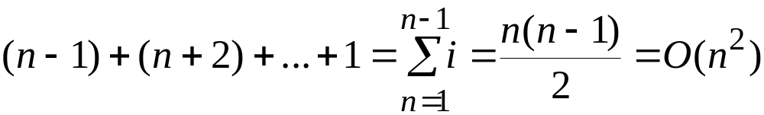
Equation 6-13
26年 11月 8日
Copyright © 1997 Oxford University Press
All Rights Reserved

Slide 29
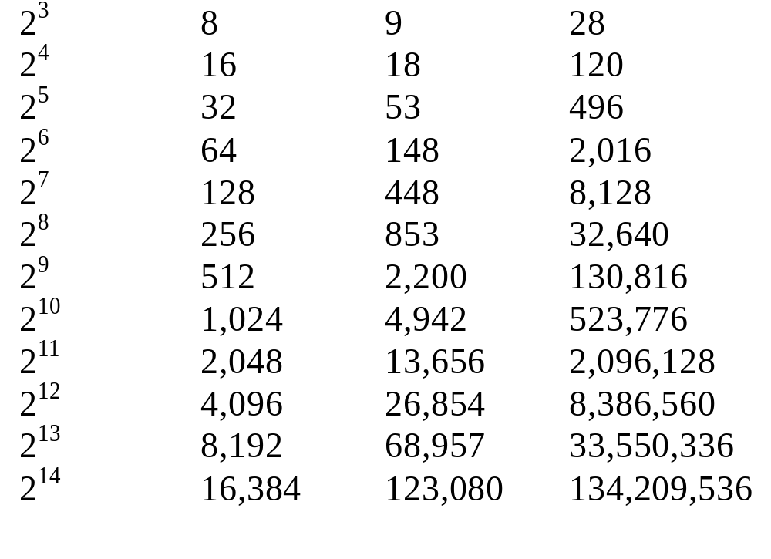
Table 6-1
n(as power of 2) n Quicksort Bubble Sort
Comparisionsª Comparisons
26年 11月 8日
Copyright © 1997 Oxford University Press
All Rights Reserved

Slide 30
Figure 6-9: A best case recursion tree for Quicksort
[4, 1, 3, 2, 6, 5, 7]
[2, 1, 3, 4, 6, 5, 7]
[2, 1, 3]
[6, 5, 7]
[1, 2, 3]
[5, 6, 7]
[1]
[3]
[5]
[7]
26年 11月 8日
Copyright © 1997 Oxford University Press
All Rights Reserved

Slide 31
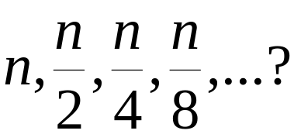
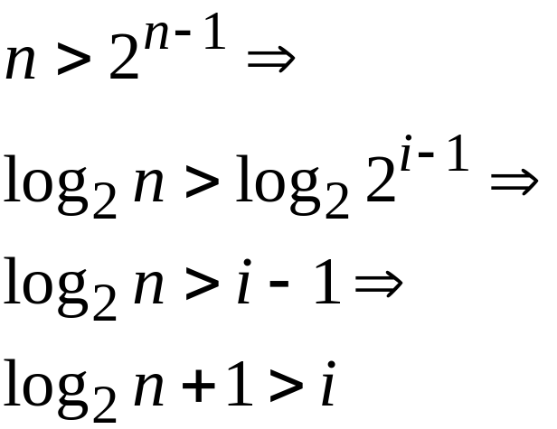
Equation 6-14
Equation 6-15
26年 11月 8日
Copyright © 1997 Oxford University Press
All Rights Reserved

Slide 32
Figure 6-10: Uniformly distributed pivot splits near the middle half the time
0
n
n
3n
n
4
2
4
about half the time, the pivot falls in the shaded area around the middle
26年 11月 8日
Copyright © 1997 Oxford University Press
All Rights Reserved

Slide 33
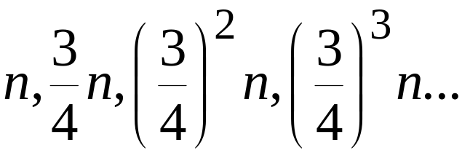
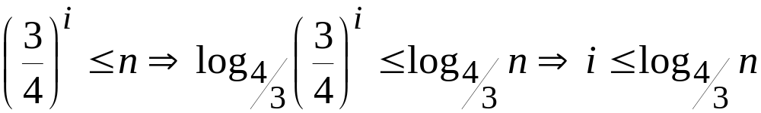
Equation 6-16
Equation 6-17
26年 11月 8日
Copyright © 1997 Oxford University Press
All Rights Reserved

Slide 34
실습
Quicksort를 프로젝트로 구현한다.
  교과서 내용을 복사해서 넣는다
  Partition을 수행하기 전과 이후를 화면에 출력해서 그 값들의 변화를 본다
  현재 구현이 int 인데 다른 형태이면 어떻게 수정하면 될까? Double 이나 char.
  좀더 확장해서 class 의 객체들인 경우에는 어떻게 수정해야 할까?
26年 11月 8日
Copyright © 1997 Oxford University Press
All Rights Reserved

